Slide 1
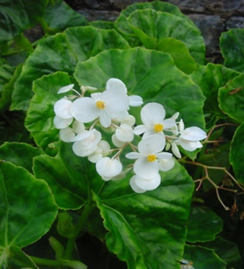
Scented Begonias
Sharon Rosenzweig
Buxton Branch ABS
Begonia odorata ‘Alba’

Slide 2
Scented Begonias
Several begonias have pleasantly scented flowers that help attract insect pollinators
Even those we can’t smell, are powerfully fragrant to their natural pollinators
As fragrance varies from plant to plant, it is not considered a helpful character for identifying begonias

Slide 3
Smell is Subjective
Smell is our most subjective sense; we all differ in how well we can smell particular fragrances, and in our reaction to those fragrances
Like many other plant characteristics, fragrance varies from individual plant to plant within a species
Plants collected in the wild will have the most potential for selecting for fragrance
Fragrance is often strongest in the female flowers
Fragrance is a trait that can be selectively bred by plant hybridizers

Slide 4
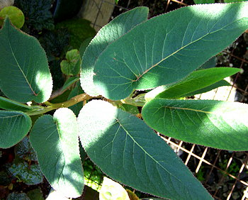
Scented Species - Brazil
Organ Mountains, trailing scandent
The inflorescences are many-flowered and blooming is profuse during the winter months.
begonia solananthera
Rain forests, stems are woody and usually bare except near the tip.
Leaves are large, long and narrow with a lightly serrated edge and slightly folded up along the mid rib, bright green and textured with a red edge. Very unusual begonia
begonia egregia

Slide 5
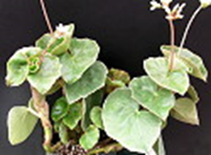
Scented Species - Brazil
Rain forests
Palmate leaves divided into slender fingers. Clusters of small, fragrant white flowers. Tall, regal, impressive.
begonia luxurians
White flowers, spicy fragrance. Thick, succulent leaves covered with white scurf. Distinctive transparent papery stipules. Grow dry.
begonia venosa

Slide 6
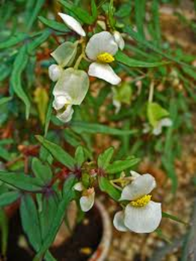
Scented Species - Africa
Tropical east African Kenya, Uganda, Tanzania
Herbaceous or woody climber
begonia meyeri-johannis
Summer-flowering, herbaceous, shade-loving perennial
tuberous, endangered
begonia dregii

Slide 7
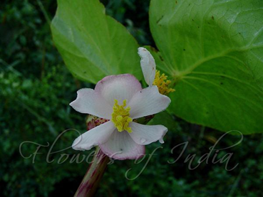
Scented Begonias - Asia
First discovered in Bombay, India in 1826.
Leaves are minutely pustulate, having white spots at the tip of pustules with a short white bristly hair coming from the center of each pustule.
Prefers warm location
begonia dipelata
East Himalayan Begonia
NE India, Nepal and Indo-China
The distinguishing feature is red elongated dots on stems and branches
begonia roxburghii

Slide 8
Scented Begonias - Asia
Rhizomatous
Discovered in Borneo 1881, steamy climate.
Produces odd bulbous growths at soil level, then shoots stems straight up into the air. It can grow to a medium-sized shrub.
begonia deliciosa

Slide 9
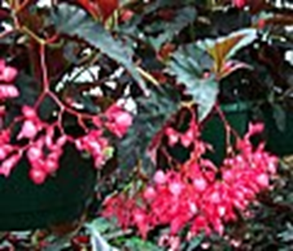
Scented Begonias - Canes
Low to medium growing, long narrow olive medium sized green leaves with lightly serrated edge. Profuse bloomer with solid light pink flowers in large open sprays that nearly hide the foliage. Very fragrant. Flowers are also highly fragrant.
begonia ‘Olive Garden’
Low growing upright cane. Small deeply pointed lobed leaves are dark bronze.
Stems and leaves have a reddish caste. Semi-trailing blooms profusely with dark rose-colored flowers that also have a light rose fragrance.
begonia ‘Edith Rose’

Slide 10
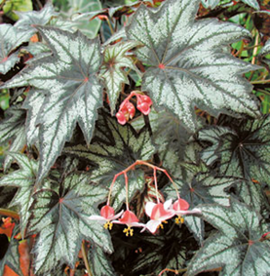
Scented Begonias - Canes
Grows in wet mountain forests and in the sunny, drier regions along roadside across Dominica, St. Lucia, St. Vincent, Grenada, Guadeloupe and Martinique.
Fibrous-rooted begonia.
Lightly fragrant especially in the evening.
begonia odorata ‘Alba’
Rex-like leaves, fibrous hybrid. When grown into a mature specimen, the flowers emit a distinct fragrance
begonia ‘Little Brother Montgomery’

Slide 11
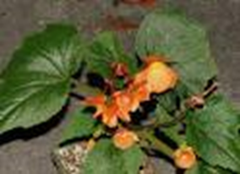
Scented Begonias - Tuberous
Low, upright begonia has many everblooming, orange, pendulous, fragrant flowers and unincised green leaves. Cane-like with evenly spaced nodes
begonia dichroa
Andean species that grows from a tuber The growth period is late spring to fall with flowers appearing August to October.
begonia cinnabarina

Slide 12
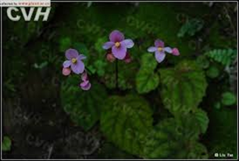
Scented Begonias - Tuberous
Leaves have undulate edges and red stalks and large, rose colored flowers on tall stalks. Restricted to rocky areas in the Andes in Bolivia, between 2500 and 3400 m. Rare in cultivation. Needs cool summers.
begonia baumannii
Distributed in China, Jiangxi, Hunan, Zhejiang, Fujian, Guangxi, Guangdong, Hainan and Hongkong
begonia fimbristipula -Hance

Slide 13
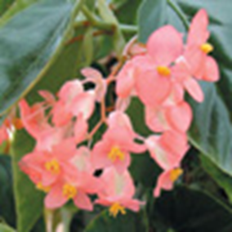
Scented Begonias - Hybrids
Logee’s Angel Wing begonia is adaptable and vibrant. Dark green and white polka dot leaves a. Reddish-pink flowers which exude an apple blossom fragrance when placed in high humidity and sunlight.
begonia ‘Bubbles’
Logee’s hybrid named for its fragrance. Bright green leaves of this fibrous Begonia bear umbels of rose-pink flowers emitting a delightful honeysuckle aroma in sunlight.
begonia ‘Honeysuckle’

Slide 14
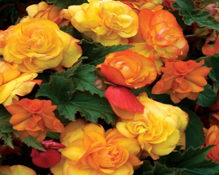
Scented Begonias - Hybrids
Logees ‘Solanthera’ hybrid. Draping growth covers itself in umbels of rose-pink blooms from January to June. Pleasant fragrance that intensifies in any sunlit exposure.
begonia ‘Potpourri’
Tuberbous
Part of the Alan Titchmarsh Collection
begonia ‘Apricot Fragrant Falls’

Slide 15
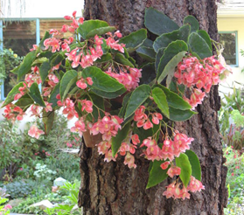
Scented Begonias - Tuberous
Begonia capensis was described by Carl Linnaeus in 1782, Cape of Good Hope
begonia capensis
Southern China
Clusters of fragrant deep salmon-pink flowers with lighter edges. Trailing stems, pointed leaves.
begonia fimbristipula

